Slide 1



CRISPResso2
Khalid Akram
3rd year PhD Biotechnology, Genome Engineering Laboratory, University of Westminster, London.

Slide 2
What is CRISPResso 2?
What questions can it answer?
CRISPresso 2 is a software tool used for analyzing CRISPR/Cas9 (and other types of CRISPR) genome editing experiments.
Provides an integrated platform for quantifying the efficiency and outcomes of CRISPR-based modifications in genomic DNA.
Helps researchers evaluate the extent of gene editing by analysing sequencing data, particularly focusing on indel (insertions and deletions) frequencies and types.
Useful for assessing the accuracy and effectiveness of CRISPR experiments.
Q1. Did my CRISPR experiment work?
Q2. What was the efficiency of the edit?
Q3. What kind of edits were made across the cell population? (insertions / deletions).

Slide 3

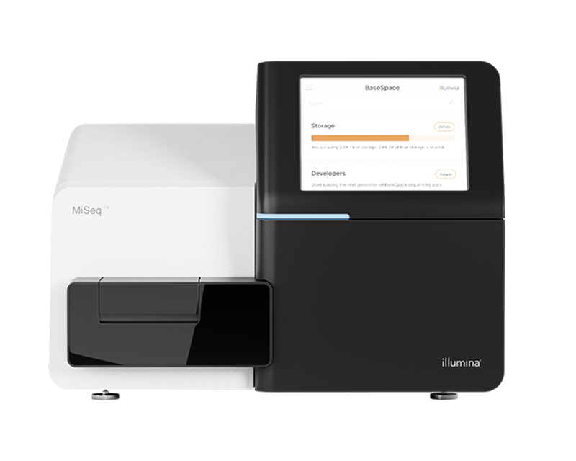

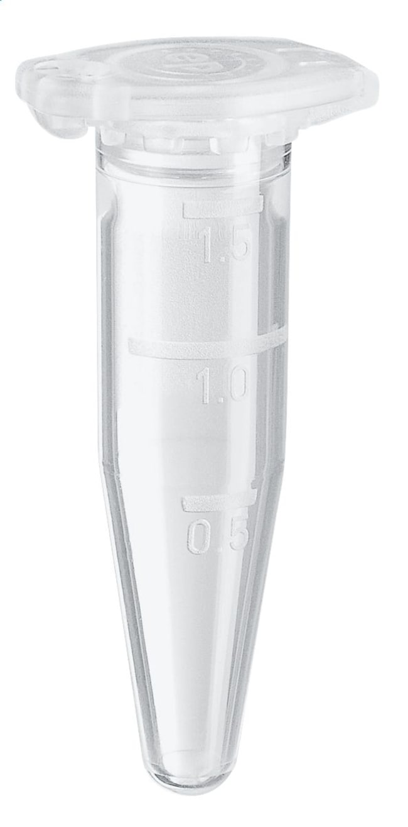
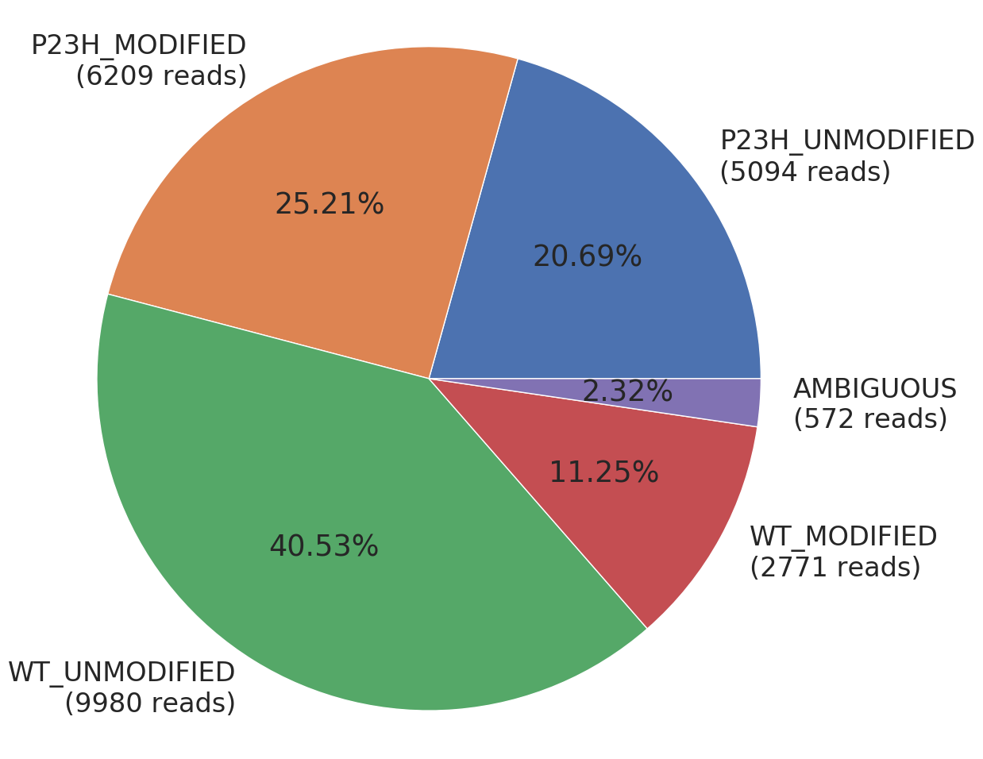
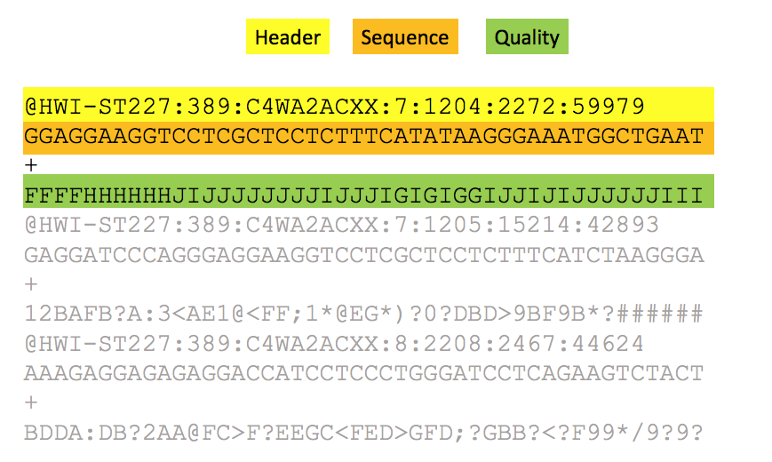
1. CRISPR experiment
2. DNA Extraction
3. Sequencing
sgRNA + CRISPR/Cas9
6. Reports & Visualisation
5. Analysis using CRISPResso2
4. Fastq format files

Slide 4



Processing of fastq files by CRISPResso2
1. Alignment
Reference amplicon
sgRNA
ACGTACGTGAGC
Aligned
sequence
ACGTACGTGAGCTGATCTGATCGATCT
Sequencing reads (fastq)
ACGTACGTGAG
CTGATCGATCT
Quantification
Window *
2. Are edits present within the quantification window?
YES
Read is
modified
3. Summary of Editing
NO
Read not
modified

Slide 5
Inputs to CRISPResso2
Editing Type
Data
Cas9
Cpf1
Fastq File 1
Fastq File 2
Base editors
AATGTCCCCCAATGGGAAGTTCATCTGGCACTGCCCACAGGTGAGGAGGTCATGATCCCCTTCTGGAGCTCCCAACGGGCCGTGGTCTGGTTCATCATCTGTAAGAATGGCTTCAAGAGGCTCGGCTGTGGTT
CRISPResso2
Prime editors
Amplicon
Custom
GTGCGGAGCCACTTCGAGCAGC
sgRNA

Slide 6
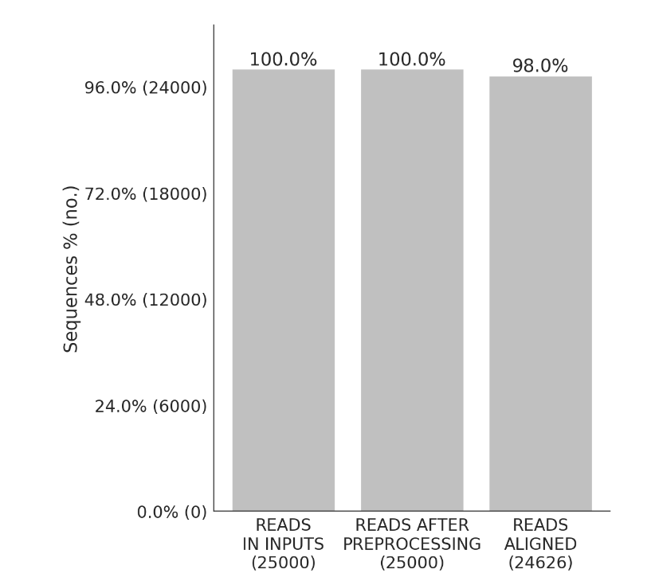
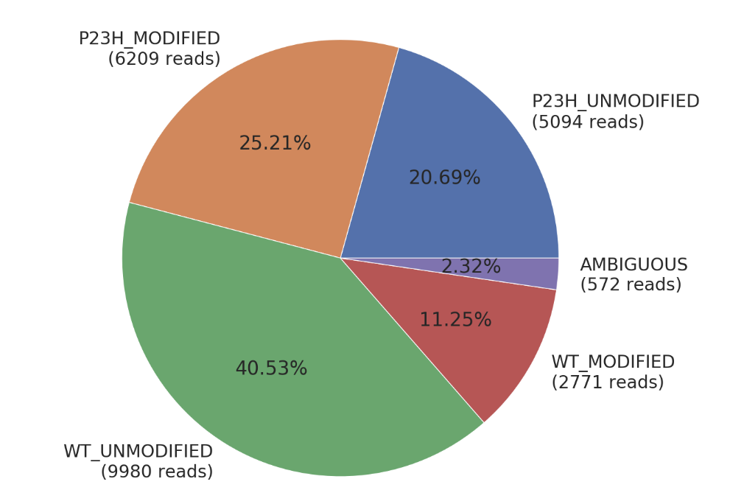
Outputs from CRISPResso2
CRISPResso2
Mapping Statistics
Quantification
of Editing

Slide 7
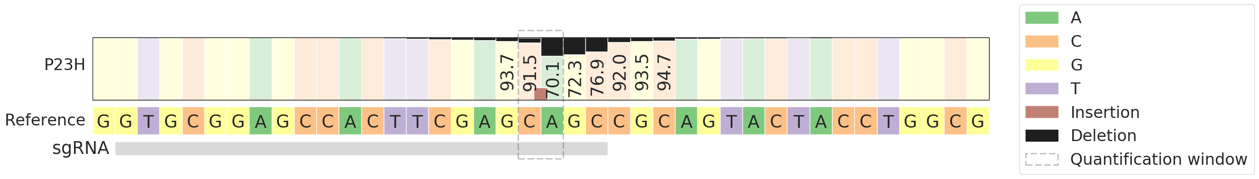
Outputs from CRISPResso2
Quantification
Window
Distribution of nucleotides in the proximity of the sgRNA and cutting site

Slide 8
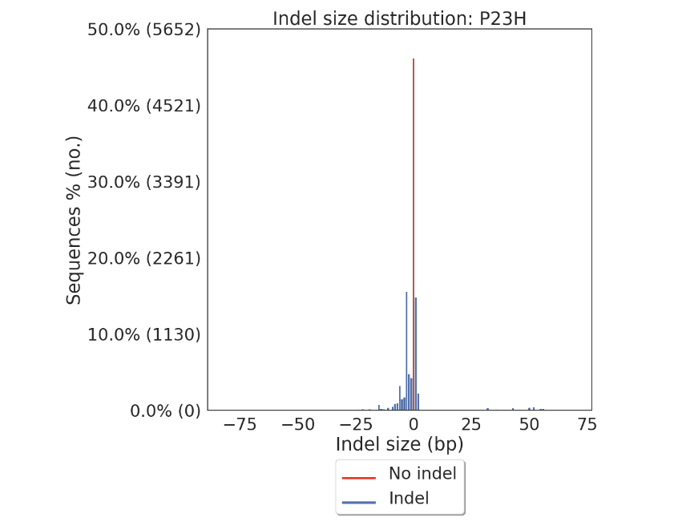
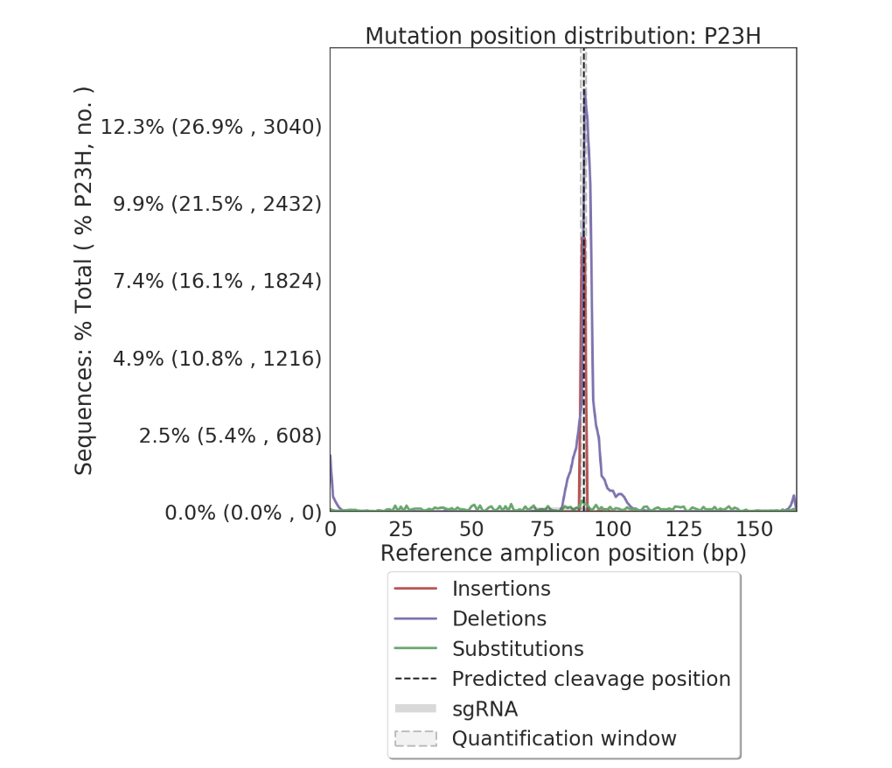
Outputs from CRISPResso2
Distribution alleles with and without indels
Frequency of insertions, deletions, and substitutions across the amplicon, including modifications outside of the quantification window.

Slide 9
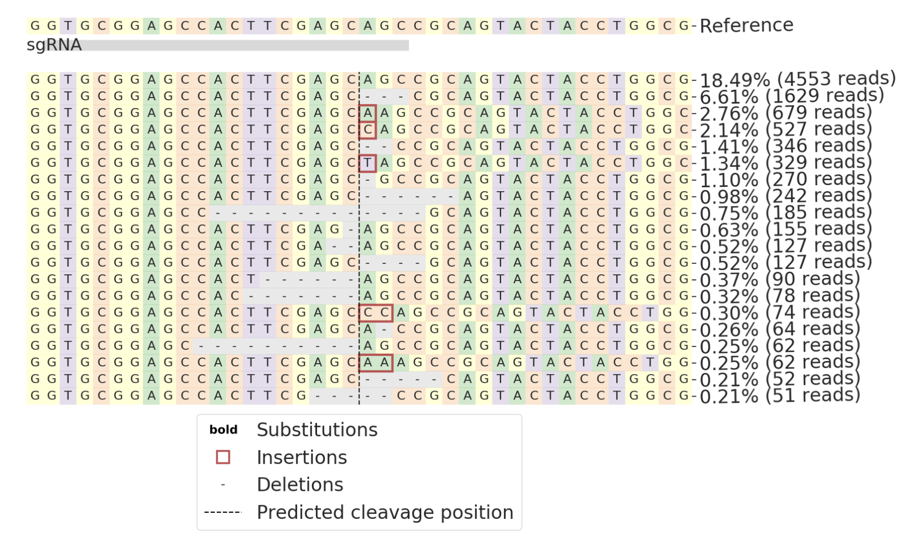
Outputs from CRISPResso2
Visualization of the distribution of identified alleles around the cleavage site for the sgRNA GTGCGGAGCCACTTCGAGCAGC. Substitutions are in bold. Red rectangles highlight inserted sequences. Horizontal dashed lines indicate deleted sequences. The vertical dashed line indicates the predicted cleavage site.

Slide 10
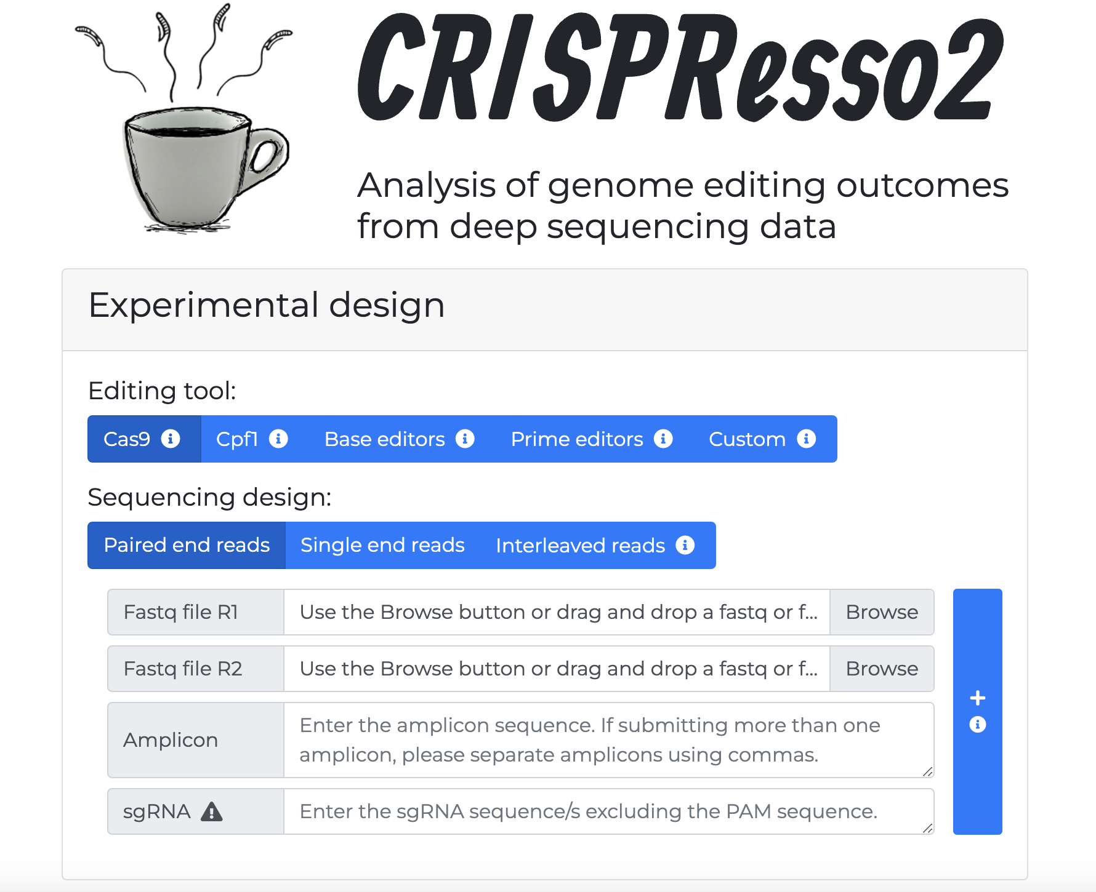
How to use CRISPResso 2 Online (Web)
http://crispresso2.pinellolab.org/
Pros:
No installation
Easy to use
Great interface
Cons:
Can’t use if offline
Slow if uploading large files
Slow if many people are using site simultaneously
URL is http rather than https – security concerns
Sometimes site is unreachable

Slide 11
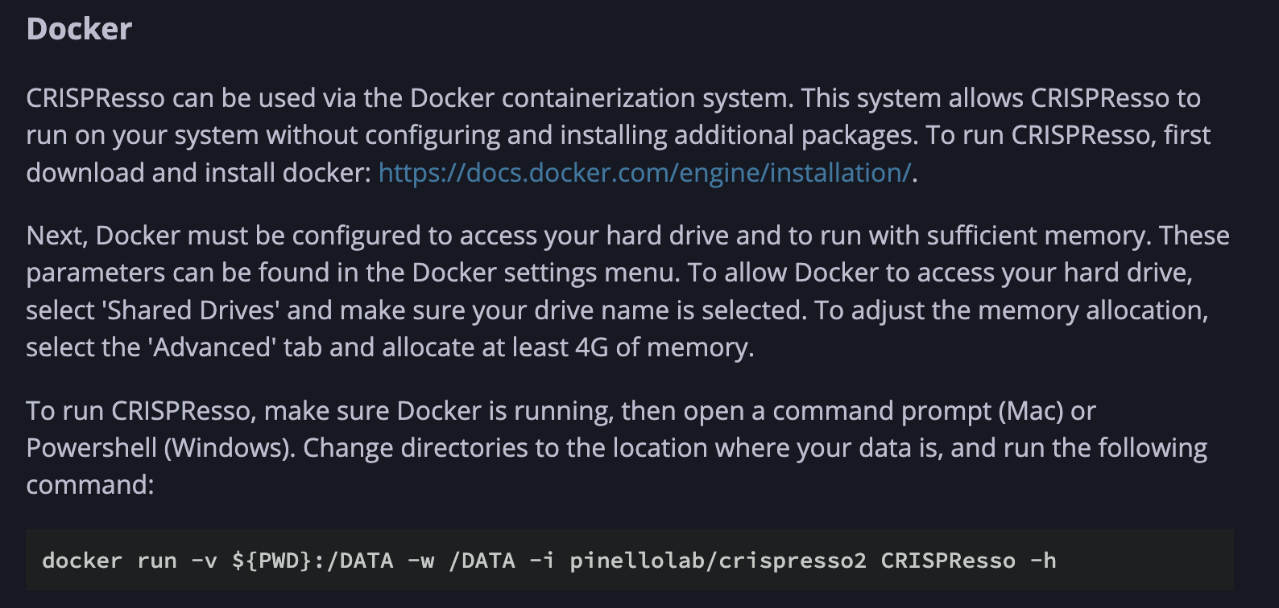
How to use CRISPResso 2 locally (on own computer)
Pros:
From official documentation:
https://docs.crispresso.com/installation.html
FAST!!
Works offline
Large files are not an issue
Docker containers make running it a breeze.
Platform independent
CRISPResso can be installed using the conda package manager Bioconda, or it can be run using the Docker containerization system.
Running via docker is probably the easiest way, as you don’t have to worry about which packages to install
Cons:
Need to be slightly more tech savvy
Command line interface can be daunting for some
Install Docker
Some command line knowledge required

Slide 12
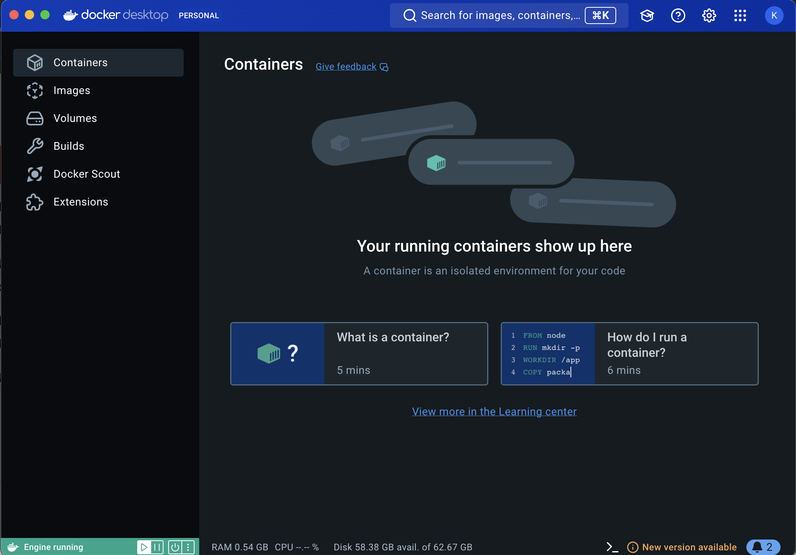
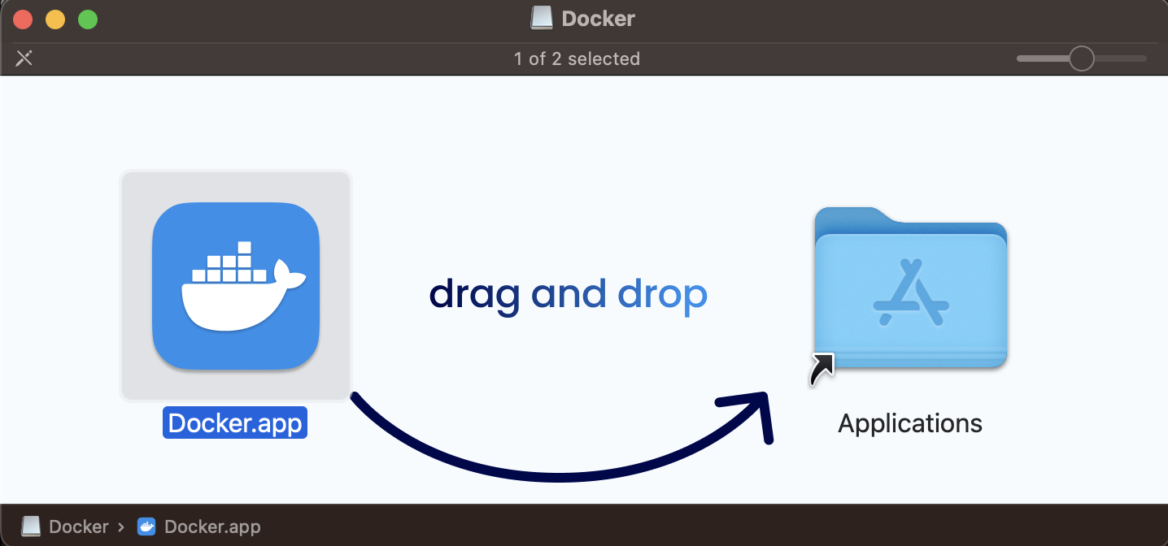
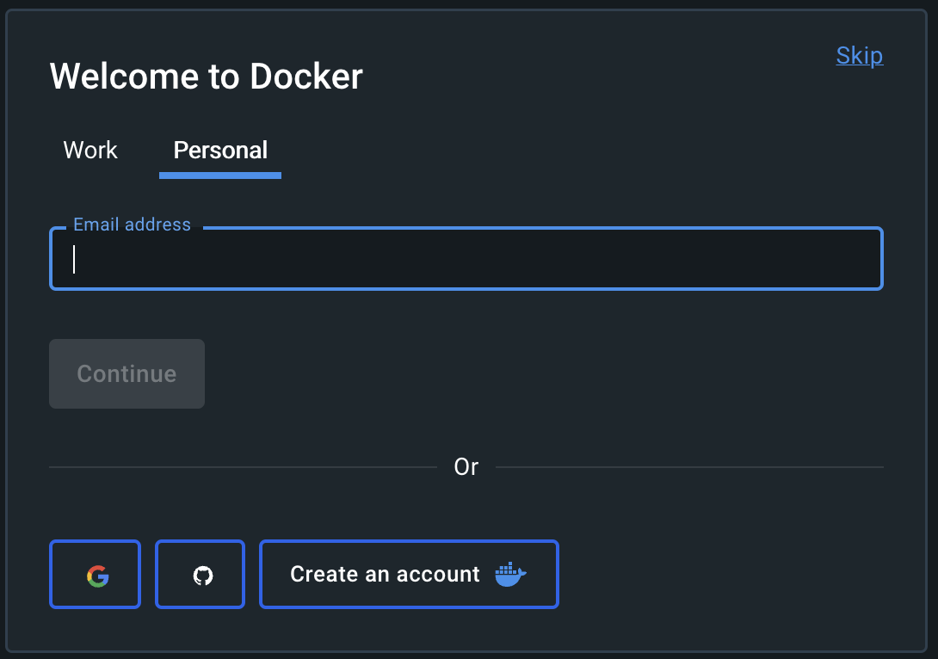
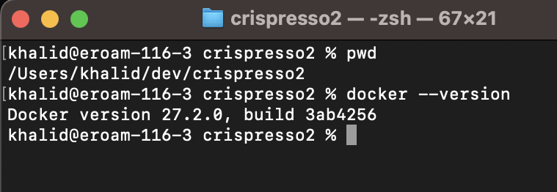
Getting Docker up and running (on Apple Mac)
https://docs.docker.com/desktop/
4. Home screen after sign up and logging in
https://docs.docker.com/desktop/install/mac-install/
1. Download the installer (Docker.dmg for Mac)
2. Double click then copy to Applications folder
5. Check Docker is running and version via terminal using docker –-version command.
3. Login using email or create a new account

Slide 13
Run CRISPresso2 via Docker
1. Execute the following command to download latest version of Crispresso2 container
docker run -v ${PWD}:/DATA -w /DATA -i pinellolab/crispresso2 CRISPResso -h
2. Data to be processed should be copied into working directory
(e.g. /dev/crispresso2)
3. Run crispressso2 with arguments as follows
docker run -v ${PWD}:/DATA -w /DATA -i pinellolab/crispresso2 CRISPResso -r1 nhej.r1.fastq.gz -r2 nhej.r2.fastq.gz -a AATGTCCCCCAATGGGAAGTTCATCTGGCACTGCCCACAGGTGAGGAGGTCATGATCCCCTTCTGGAGCTCCCAACGGGCCGTGGTCTGGTTCATCATCTGTAAGAATGGCTTCAAGAGGCTCGGCTGTGGTT
4. If executed successfully a directory and HTML file will be created as follows:
a) CRISPResso_on_nhej.r1_nhej.r2/
b) CRISPResso_on_nhej.r1_nhej.r2.html
5. Open HTML file 4(b) in browser to view reports

Slide 14

Any questions?

